Slide 1
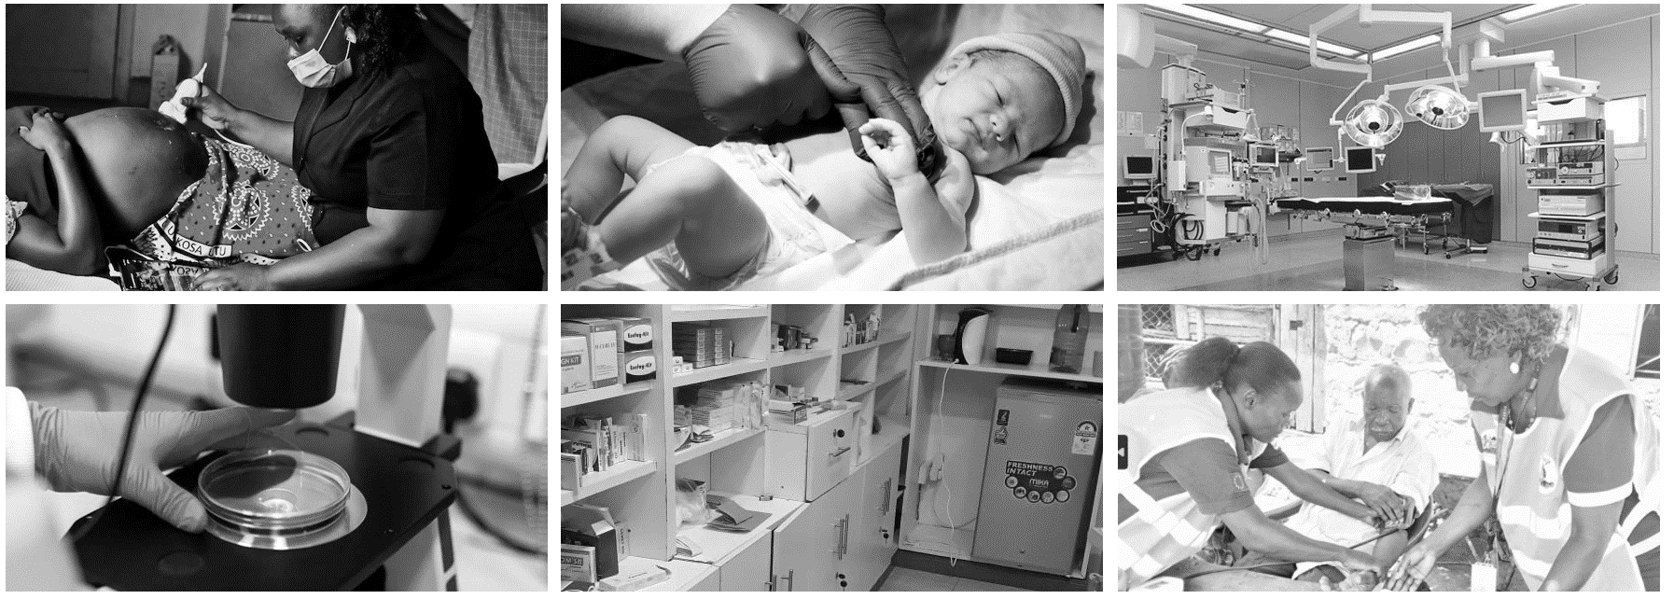
QIncubate Healthcare Solutions Ltd Pragmatic innovations for optimal health outcomes

Slide 2
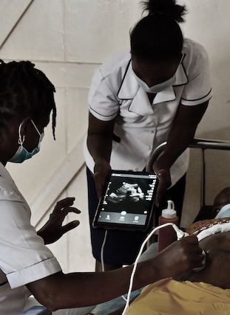
Outline
About us
Corporate Capability and Market Knowledge
Key personnel & Organogram
Our value proposition
Customer onboarding

Slide 3

ABOUT US
A startup health systems consulting firm incorporated in 2024 to strengthen health systems by developing practical solutions that enhance availability and accessibility of quality, cost effective healthcare.
Our mission is to contribute to value-based healthcare by harnessing the power of continuous quality improvement and sparking quality consciousness in developing countries.
QIncubate Healthcare Solutions Ltd
CORE COMPETENCIES
Strategic focus
Global Presence
Health Systems Assessments: Facility, Laboratory, Supply Chains.
01
02
Continuous Quality Improvement (CQI)
Collaborative diagnosis of challenges
Co-creation of effective interventions
Client empowerment
Health Systems Strengthening
Monitoring and evaluation of interventions; development of suitable knowledge management systems
Africa: Kenya, Eritrea, Namibia, Nigeria, Somalia, Somaliland, Uganda, Zambia.
Kenya: 40+ Counties
Customized health workforce capacity building.
Innovative technology integration.
Contact Us
Phone
email
03
04
Eaton Place, Second Floor, United Nations Crescent, Gigiri.
254 721319122
qincubatehealthcareltd@gmail.com
aronuel@gmail.com

Slide 4




Corporate Capability and Market knowledge
Seasoned multidisciplinary team
50+ Years collective experience strengthening systems across all health system pillars
Provide services to public and private sector
CQI as the fundamental principle in providing value-based healthcare for improved health outcomes
Power of collaboration
Pragmatic leveraging of technology

Slide 5
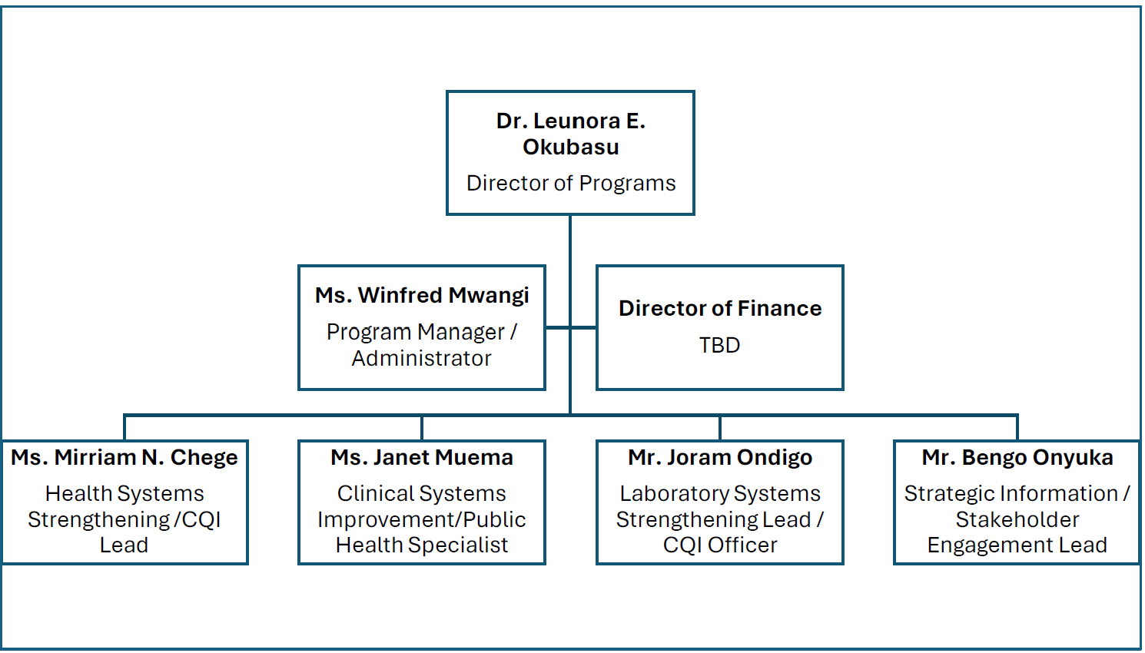
Our organogram

Slide 6
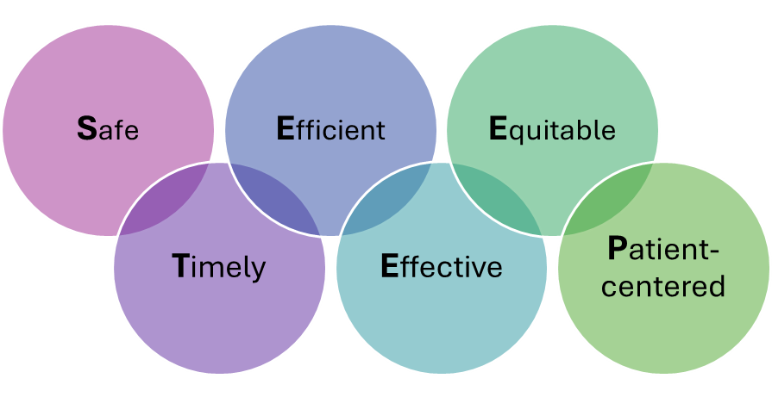
Case for Quality in Healthcare
Quality is..
Kenya has made significant strides in improving health indicators
Iron Triangle Theory
Challenge: simultaneous achievement of low cost, high quality, open access
Opportunities for standardization of care with measurable outcomes is possible – irreducible minimums
CQI approaches can facilitate increase quality, efficiency in cost & open access

Slide 7
Our Value Proposition
Aligned to SafeCare approach – combining the power of digital innovation and internationally accredited quality measurement tools in quality measurement
Domain knowledge of healthcare service delivery in the country:
health system assessments, capacity building using CQI approaches, Coaching and mentoring health workers
Vast experience in private and public sector
Established expansive networks with key stakeholders
Wide geographical coverage (40+ Counties in Kenya)

Slide 8
Our approach
Brand visibility: Adherence to the policies and regulations pertaining to certification; Promote opportunities and services available to the HF apart from certification
Stakeholder engagement
Private sector
Primary Care Networks
Situation analysis
Existing facilities
New facilities
Customize support to HF
Bespoke solutions for each facility
Mainstreaming CQI
Professional networks
Professional bodies
Regulatory bodies
Public sector
Work within established structures
Nurture the optimal environment for improvement
Coaching and mentoring HFs
CQI
Performance review meetings

Slide 9

Customer onboarding
Government:
National & County
Professional bodies
Professional networks
Professional forums: conferences, exhibitions, review meetings
Insurance firms

Slide 10

Thank you

